Slide 1
CDISC Biomedical Concepts and Dataset Specializations Pragmatic Implementation and Tangible Value
Jon Neville, Senior Director Standards Development, CDISC
Lex Jansen, Senior Director Data Science Development, CDISC
Linda Lander, Director Data Science, CDISC

Slide 2




Meet the Speakers
Jon Neville
Title: Senior Director, Standards Development
Organization: CDISC
Jon Neville has been working in CDSIC standards development since 2009. He has been working at CDISC for 6 years, where he is currently Senior Director, Standards Development at CDISC
Lex Jansen
Title: Senior Director, Data Science Development
Organization: CDISC
Lex Jansen is an independent consultant, currently working as Senior Director, Data Science Development at CDISC. Before he was a Principal Solution Consultant and Principal Software Developer at SAS Institute.
Linda Lander
Title: Director, Data Science
Organization: CDISC
Linda Lander is an independent contractor, currently working as Director Data Science and Biomedical Concepts Product Owner at CDISC. Before she was Director Data Standards at GlaxoSmithKline
Notes:
The Session Chair will introduce you based on the information you provide on this slide.
Instructions:
1. Select one of the two ‘Meet the Speaker’ templates based upon how many presenters you have.
2. Insert a medium or high resolution professional bio photo of yourself and format it to the dimensions of the placeholder image(s).
3. Place bio photo(s) over the placeholder(s) and delete the placeholder image(s).
4. Fill in your name, title and organization in the text boxes provided.
5. Insert short bio’s in the text box provided. If the quantity of presenters does not allow adequate space for bios on the slide, delete this text and replace it with short bios of all presenters.

Slide 3
Disclaimer and Disclosures
The views and opinions expressed in this presentation are those of the author(s) and do not necessarily reflect the official policy or position of CDISC.

Slide 4
Agenda
CDISC Biomedical Concepts - Introduction and Background
SDTM Dataset Specializations as Define-XML Building Blocks
Retrieval of BCs and SDTM Dataset Specializations using CDISC Library APIs
Key Accomplishments, Current Status and What’s Coming

Slide 5
CDISC Biomedical Concepts and SDTM Dataset Specializations
Background and Introduction

Slide 6
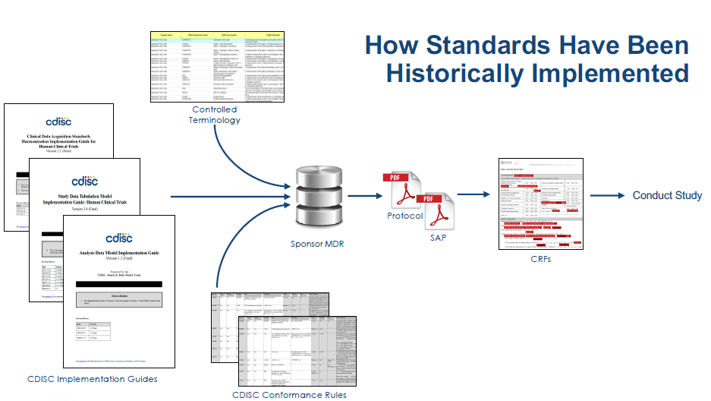
CDISC Biomedical Concepts and SDTM Dataset Specializations
Notes:
Explicit Variable Relationships
Extend Foundational Standards
Objectives
Improve understanding of what the variables are and how they are used
Help users find the variables they need within the overwhelming set of available variables.
Biomedical Concepts
What variables are needed to specify the test
Information on how the variables relate to each other
Help build validation
Help build transformation layer between CDASH and SDTM.
Help with data collection – what pieces are needed
Support analysis – what variables needed to define parameters for analysis

Slide 7
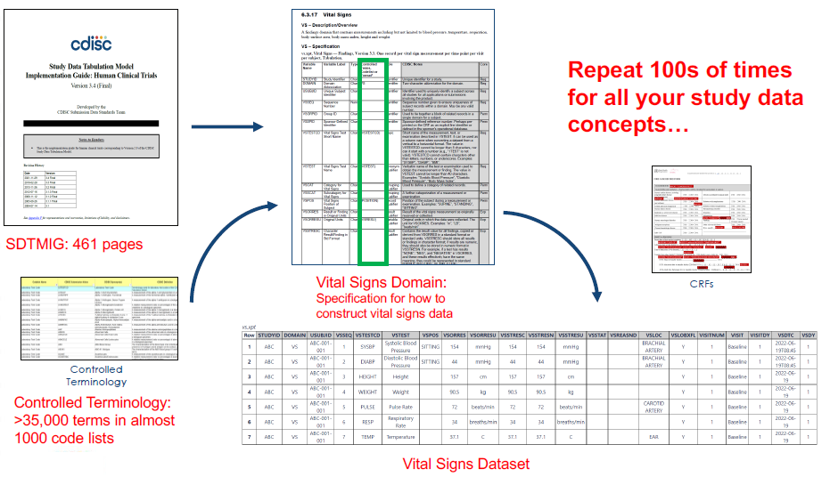
Example: Vital Signs in SDTM
Notes:
Explicit Variable Relationships
Extend Foundational Standards
Objectives
Improve understanding of what the variables are and how they are used
Help users find the variables they need within the overwhelming set of available variables.
Biomedical Concepts
What variables are needed to specify the test
Information on how the variables relate to each other
Help build validation
Help build transformation layer between CDASH and SDTM.
Help with data collection – what pieces are needed
Support analysis – what variables needed to define parameters for analysis

Slide 8
CDISC Biomedical Concepts and SDTM Dataset Specializations
Problem:
Labor-intensive; requires extensive knowledge of standards documents
Subject to interpretation (and therefore, misinterpretation)
Can result in inconsistent implementation
The intense effort required is a barrier to standards adoption
CDISC has evolved:
CDISC Library has published data standards as groups of linked metadata
Defined relationships between variables, associated terminology codelists, and linkages across standards
CDISC 360 piloted the development of linked Biomedical Concept metadata to enable end to end automation
Notes:
Explicit Variable Relationships
Extend Foundational Standards
Objectives
Improve understanding of what the variables are and how they are used
Help users find the variables they need within the overwhelming set of available variables.
Biomedical Concepts
What variables are needed to specify the test
Information on how the variables relate to each other
Help build validation
Help build transformation layer between CDASH and SDTM.
Help with data collection – what pieces are needed
Support analysis – what variables needed to define parameters for analysis

Slide 9
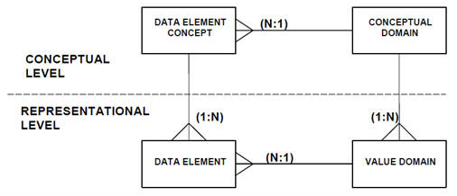
What Is a Biomedical Concept (BC)?
ISO 11179 Definition: A unit of knowledge created by a unique combination of characteristics
Notes:
Explicit Variable Relationships
Extend Foundational Standards
Objectives
Improve understanding of what the variables are and how they are used
Help users find the variables they need within the overwhelming set of available variables.
Biomedical Concepts
What variables are needed to specify the test
Information on how the variables relate to each other
Help build validation
Help build transformation layer between CDASH and SDTM.
Help with data collection – what pieces are needed
Support analysis – what variables needed to define parameters for analysis

Slide 10
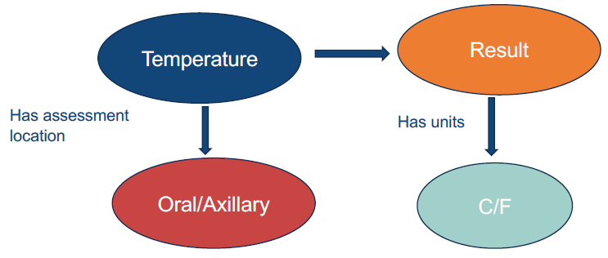
What Is a Biomedical Concept (BC)?
ISO 11179 Definition: A unit of knowledge created by a unique combination of characteristics
Independent of study
Independent of a representation in any standard, but can be tethered to a standard
Notes:
Explicit Variable Relationships
Extend Foundational Standards
Objectives
Improve understanding of what the variables are and how they are used
Help users find the variables they need within the overwhelming set of available variables.
Biomedical Concepts
What variables are needed to specify the test
Information on how the variables relate to each other
Help build validation
Help build transformation layer between CDASH and SDTM.
Help with data collection – what pieces are needed
Support analysis – what variables needed to define parameters for analysis

Slide 11
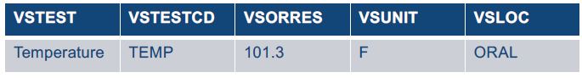
What Is a Biomedical Concept (BC)?
Conceptual Layer
Implementation Layer
Notes:
Explicit Variable Relationships
Extend Foundational Standards
Objectives
Improve understanding of what the variables are and how they are used
Help users find the variables they need within the overwhelming set of available variables.
Biomedical Concepts
What variables are needed to specify the test
Information on how the variables relate to each other
Help build validation
Help build transformation layer between CDASH and SDTM.
Help with data collection – what pieces are needed
Support analysis – what variables needed to define parameters for analysis

Slide 12
CDISC Biomedical Concepts and SDTM Dataset Specializations
Developing Biomedical Concepts allows accurate and more consistent implementation of the conceptual content being implemented
3 Key pieces of the Pragmatic Implementation:
Extend foundational standards
Add explicit relationships between variables
Additional operational metadata, e.g., data type, etc.
Conceptual Layer – abstract BC’s
Provides semantics - aligned with NCI terminology
Supports study design, Schedule of Activities (SOA)
Implementation Layer - Dataset Specializations with VLM definitions
Supports programmers
Pre-configured building blocks for Define-XML
Tailored to BCs to link with unambiguous semantics & definitions
Dataset specializations as an extended dataset structure
Notes:
Explicit Variable Relationships
Extend Foundational Standards
Objectives
Improve understanding of what the variables are and how they are used
Help users find the variables they need within the overwhelming set of available variables.
Biomedical Concepts
What variables are needed to specify the test
Information on how the variables relate to each other
Help build validation
Help build transformation layer between CDASH and SDTM.
Help with data collection – what pieces are needed
Support analysis – what variables needed to define parameters for analysis

Slide 13
SDTM Dataset Specializations
Building Blocks for Define-XML

Slide 14
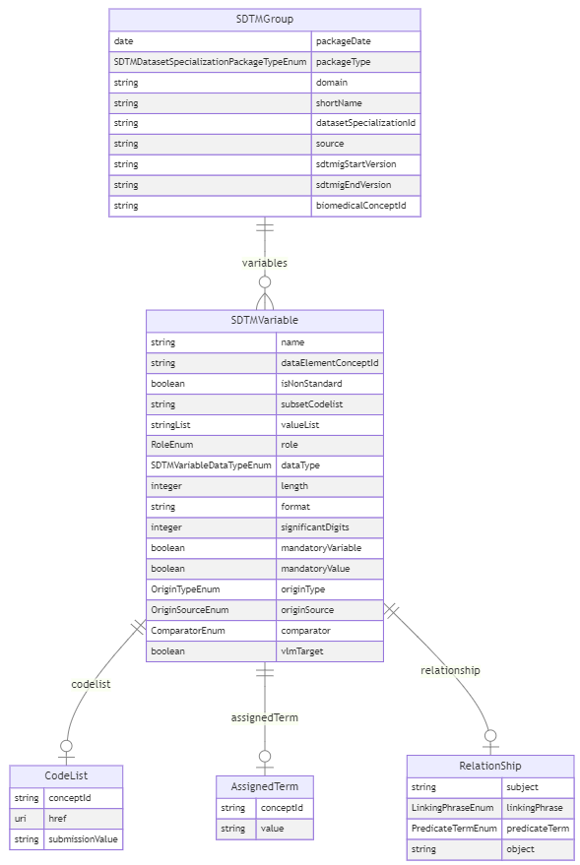
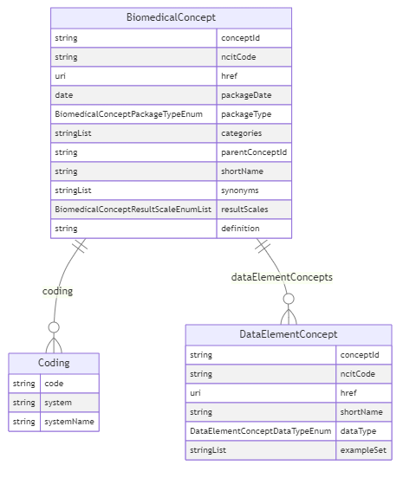
The logical Model

Slide 15
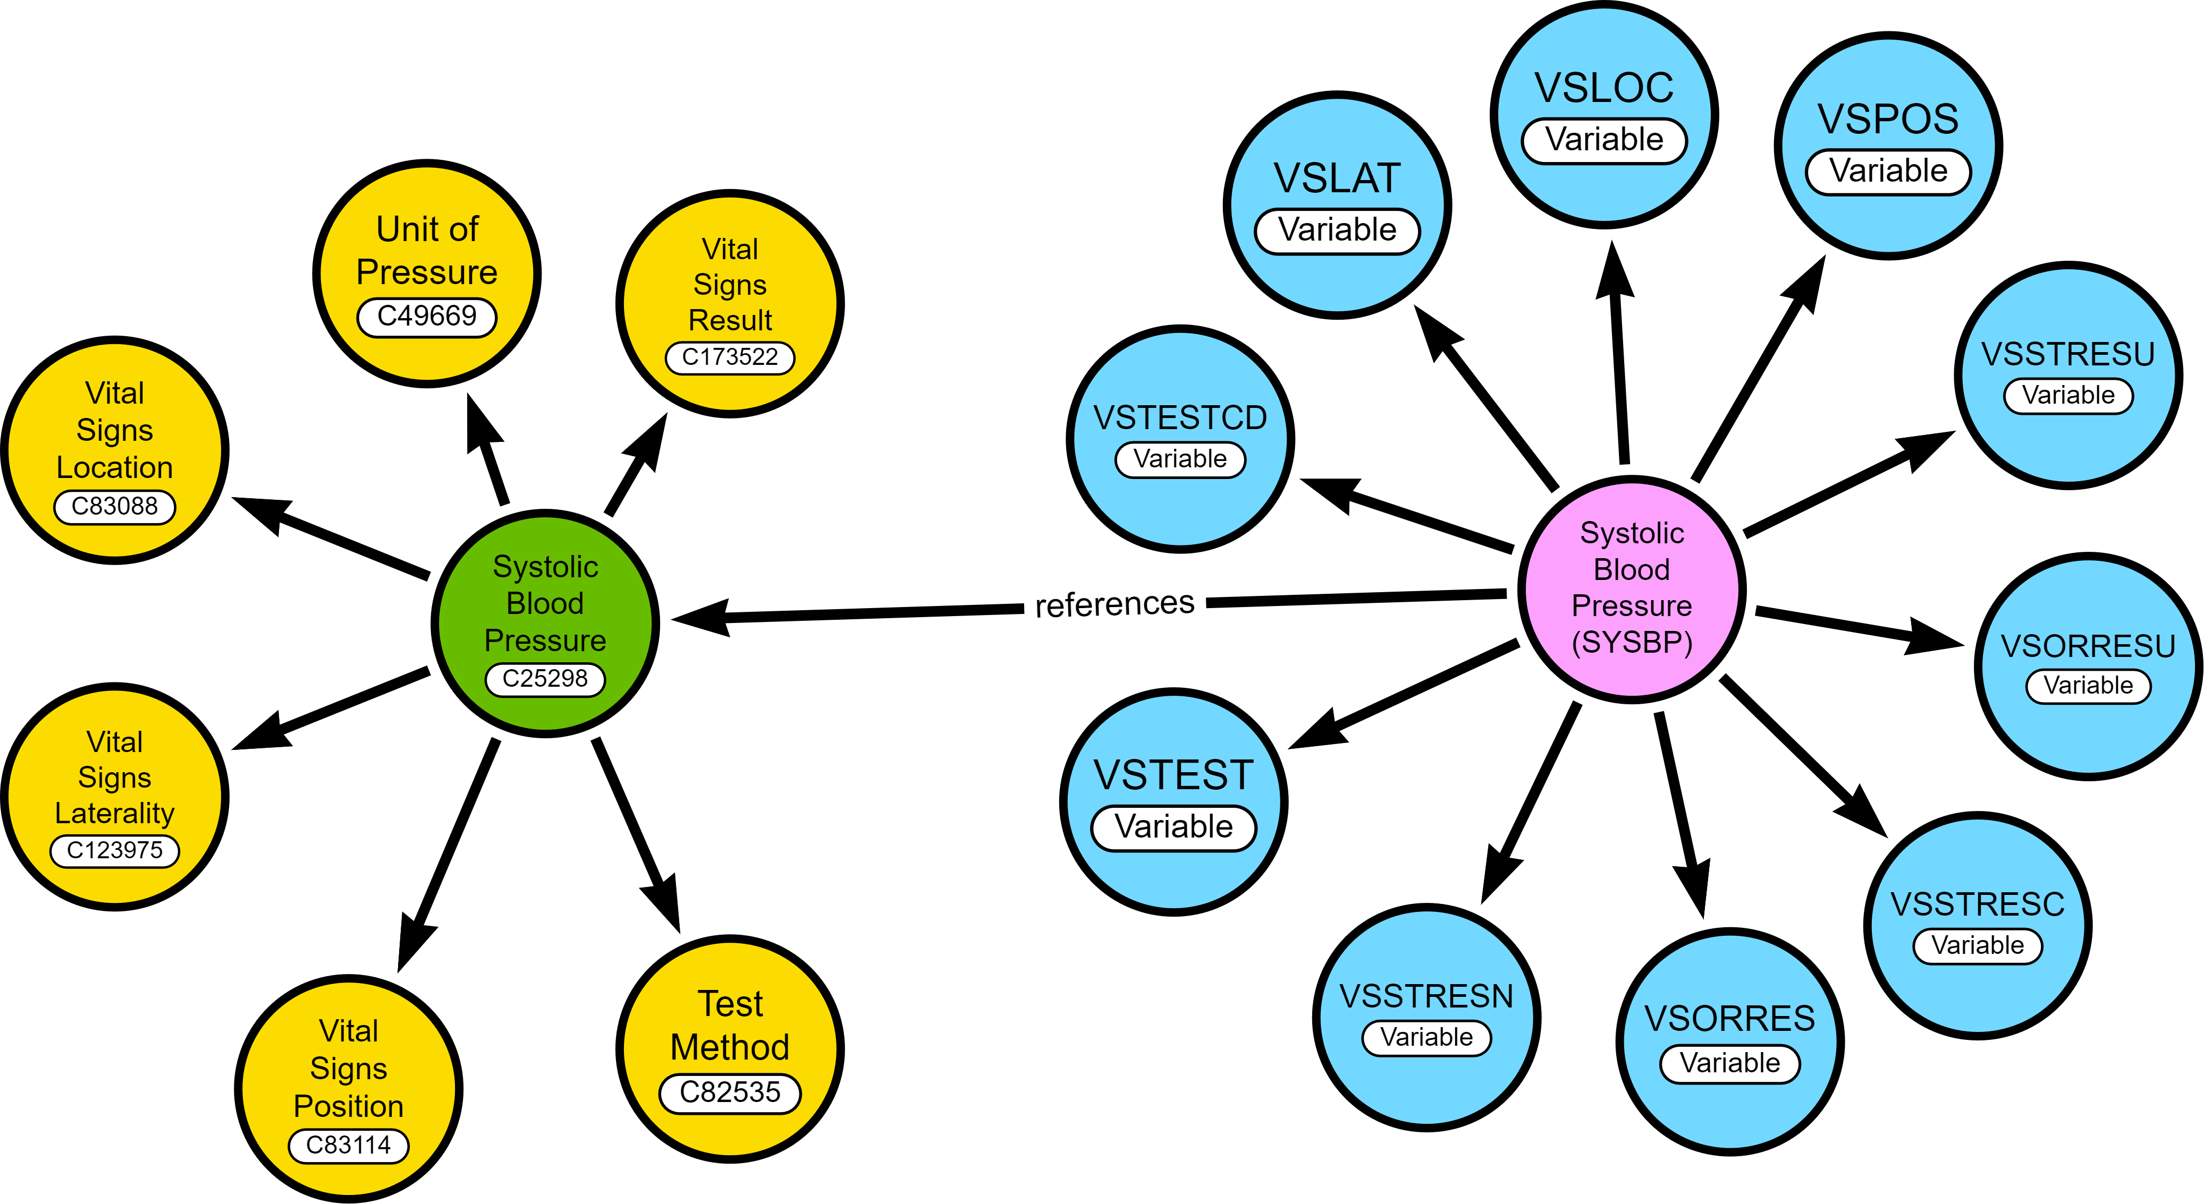
CDISC Biomedical Concepts and SDTM Dataset Specializations

Slide 16
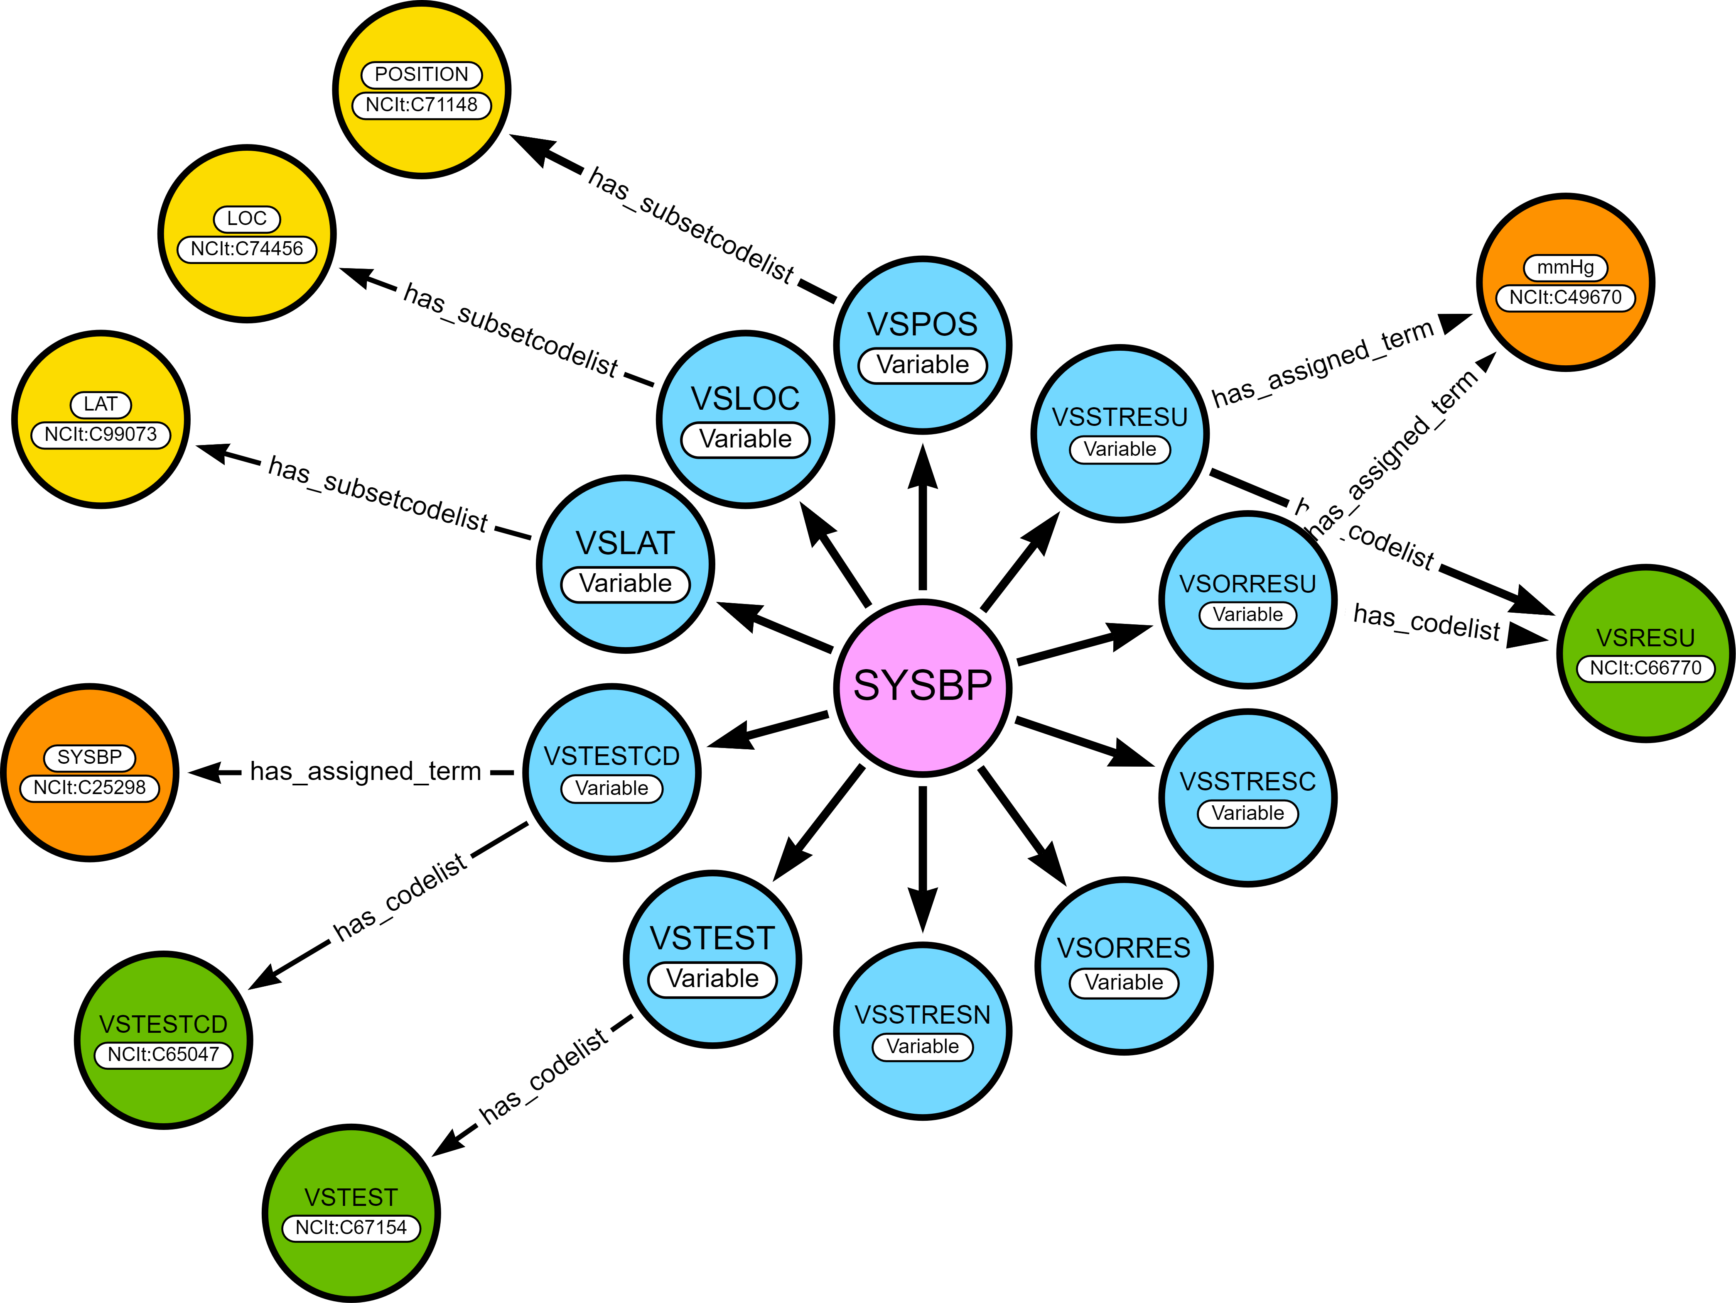
SDTM Dataset Specializations

Slide 17
SDTM Dataset Specializations
Attribute | Description
datasetSpecializationId | Identifier for SDTM Value Level Metadata group
domain | Domain for the SDTM specialization group
shortName | SDTM group short name which provides a user friendly and intuitive name for the datasetSpecializationId
source | SDTM VLM Source which categorizes VLM groups by topic variable
sdtmigStartVersion | The earliest SDTMIG version applicable to the SDTM dataset specialization
sdtmigEndVersion | The last SDTMIG version that is applicable to the SDTM dataset specialization
biomedicalConceptId | Biomedical Concept identifier

Slide 18
SDTM Dataset Specializations
Attribute |  | Description
Name |  | Name of the variable included in the SDTM dataset specialization
dataElementConceptId |  | Biomedical Concept Data Element Concept identifier
isNonStandard |  | Flag that indicates if the variable is a non-standard variable
codelist | conceptId | C-code for a codelist in NCIt
 | href | Link to NCIt for the codelist
 | submissionValue | CDISC submission value for the codelist
subsetCodelist |  | Subset codelist short name
valueList |  | List of SDTM submission values used if subset codelist is not applicable
assignedTerm | conceptId | C-code for assigned term in NCIt
 | value | Submission value for assigned term in NCIt if it exists, or an assigned value which will be the default value
role |  | SDTM variable role

Slide 19
SDTM Dataset Specializations
Attribute |  | Description
relationship | Subject | Subject in a variable relationship
 | linkingPhrase | Variable relationship descriptive linking phrase
 | predicateTerm | Short variable relationship linking phrase for programming
 | object | Object in a variable relationship
datatype |  | Variable data type
length |  | Variable length
format |  | Variable display format
significantDigits |  | Variable significant digits
mandatoryVariable |  | Indicator that variable must be present within the SDTM group
mandatoryValue |  | Indicator that variable must be populated within the SDTM group
originType |  | Variable origin type (Assigned, Collected, Derived, Protocol, Predecessor)
originSource |  | Variable origin source (Investigator, Sponsor, Subject, Vendor)
comparator |  | Comparison operator for SDTM group variables included in VLM (EQ, IN)
vlmTarget |  | Target variable for VLM (true/false)

Slide 20
Define-XML v2.1 document with SDTM Dataset Specialization: - Value Level Metadata and - Controlled Terminology metadata for the RS, TR, and TU domains
SDTM Dataset Specializations are considered pre-configured building blocks, from which end-users can select and configure to build Define-XML Value Level Metadata
Exercise: present Oncology RECIST 1.1 SDTM Dataset Specializations as Value Level Metadata in Define-XML v2.1
Oncology RECIST 1.1
13 Biomedical Concepts
13 SDTM Specializations (RS, TR, TU))
REST API:
GET Biomedical Concepts: /mdr/bc/biomedicalconcepts?category=RECIST 1.1
GET SDTM Specializations: /mdr/specializations/sdtm/datasetspecializations?domain=RS

Slide 21







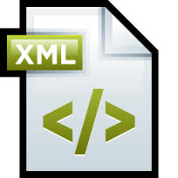
Create Define-XML process
CDISC Library
RS, TU, TU column / table metadata*
CDISC SDTM Dataset Specialization Metadata
Metadata representation of Define-XML
Table Metadata
Column Metadata
Value Level Metadata
CodelistMetadata
Study Metadata
Standards Metadata
CDISC Library Terminology Metadata
Create Study / Standards metadata
Define-XML v2.1 + VLM + Terminology
*) Add lengths, origins, NSV metadata from a spreadsheet

Slide 22
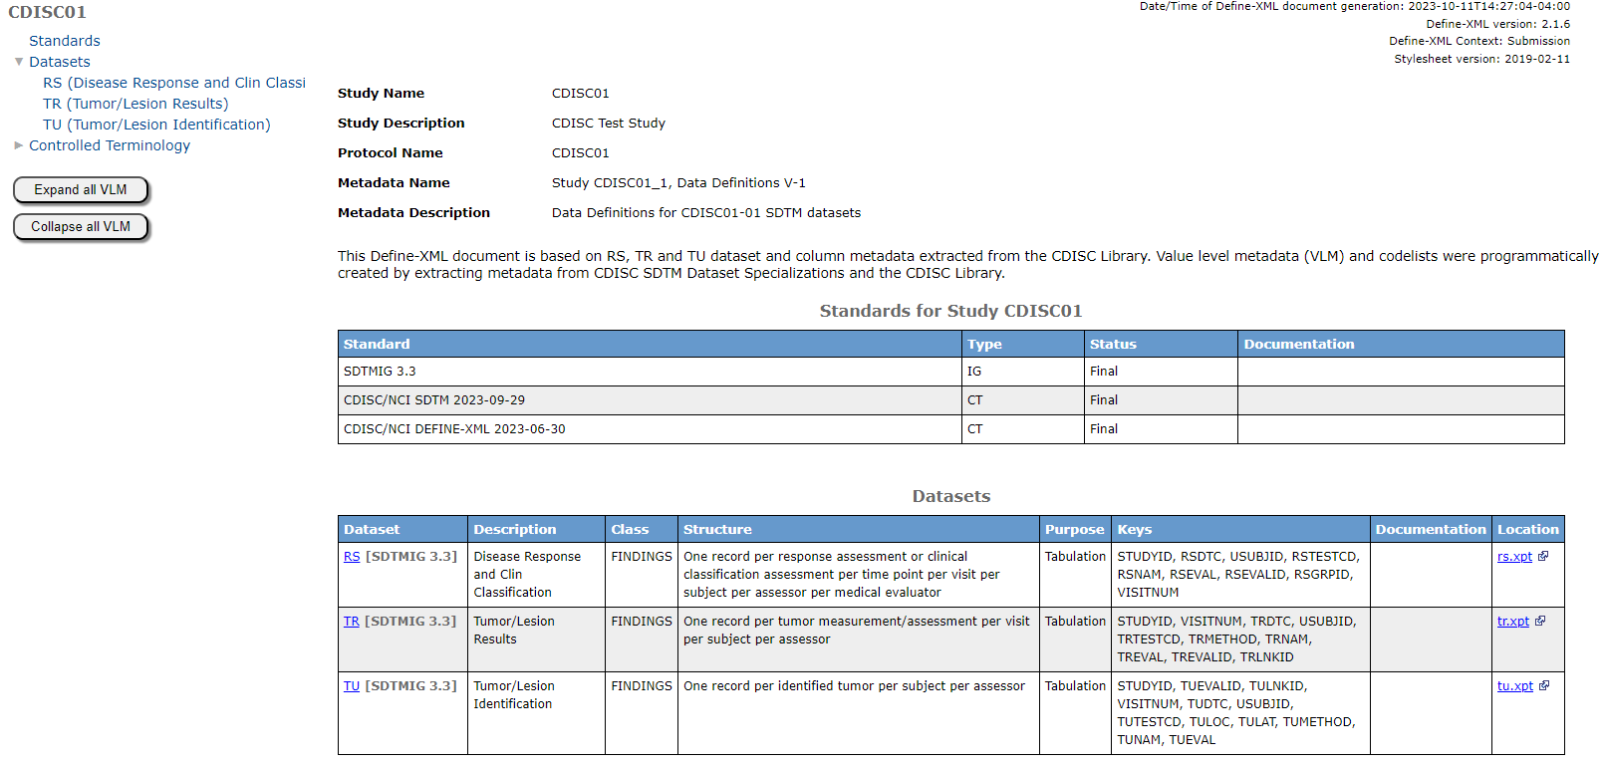
Define-XML v2.1 document with SDTM Dataset Specialization: - Value Level Metadata and - Controlled Terminology metadata for the RS, TR, and TU domains

Slide 23
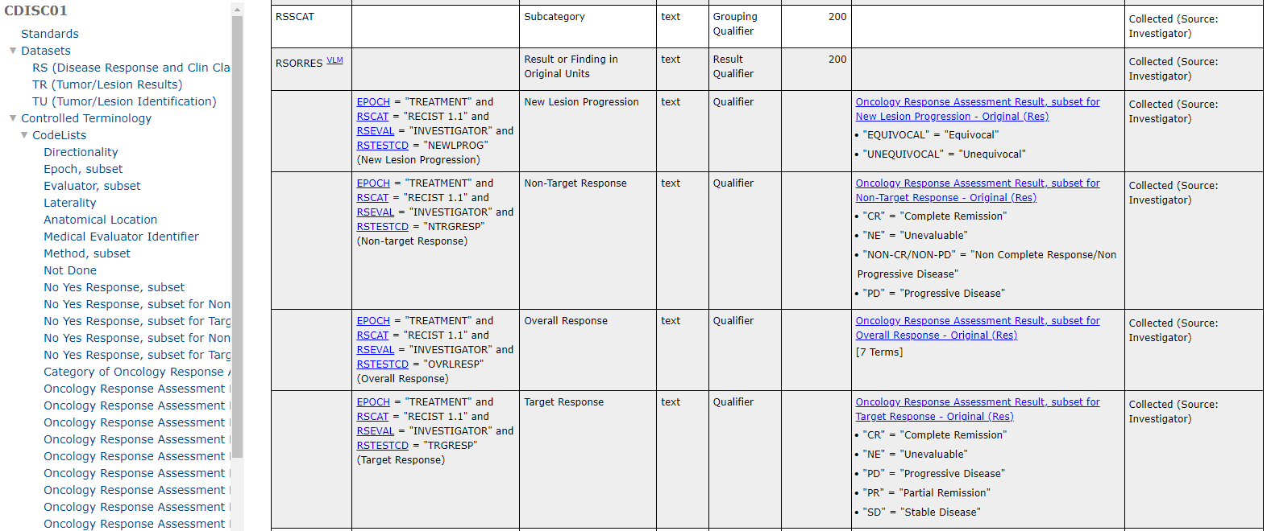
Define-XML v2.1 document with SDTM Dataset Specialization: - Value Level Metadata and - Controlled Terminology metadata for the RS, TR, and TU domains

Slide 24
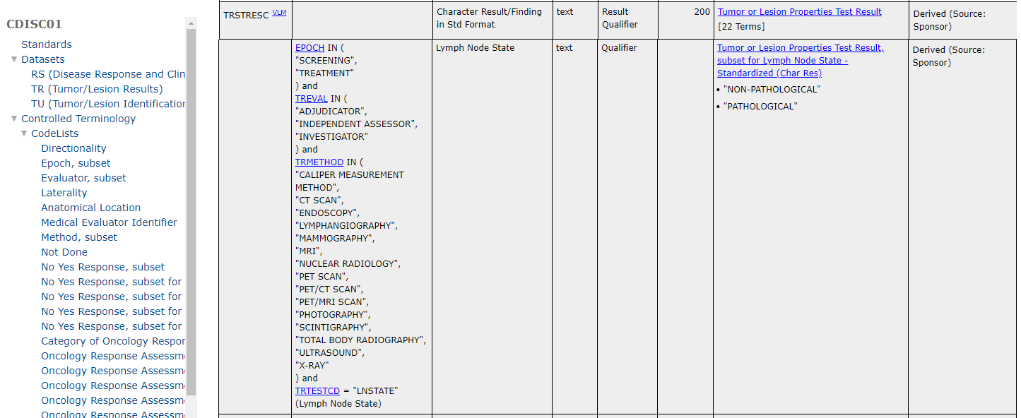
Define-XML v2.1 document with SDTM Dataset Specialization: - Value Level Metadata and - Controlled Terminology metadata for the RS, TR, and TU domains

Slide 25
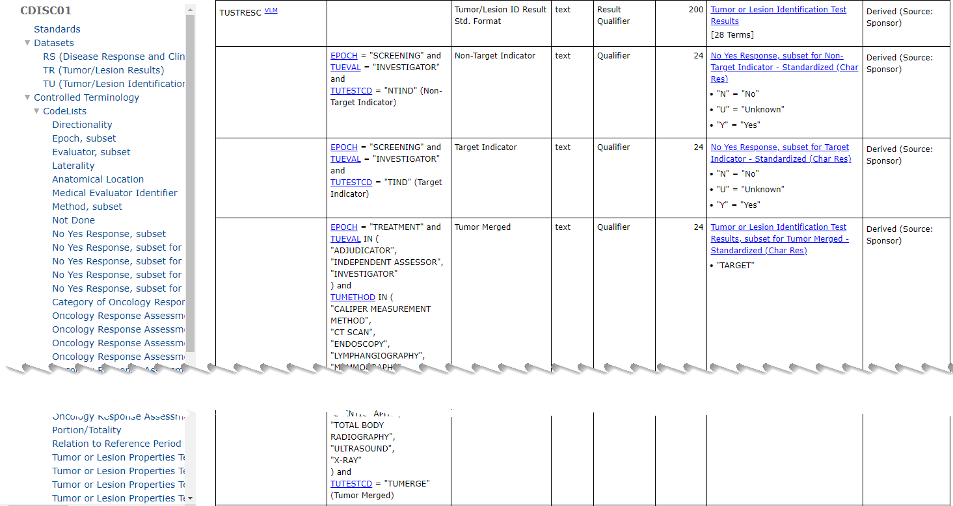
Define-XML v2.1 document with SDTM Dataset Specialization: - Value Level Metadata and - Controlled Terminology metadata for the RS, TR, and TU domains

Slide 26
Conclusion
SDTM Dataset Specializations can be represented as Value Level Metadata definitions in Define-XML v2.1.
These definitions contain detailed metadata, including Controlled Terminology subsets.
The SDTM Dataset Specializations can be considered pre-configured building blocks, from which end-users can select and configure to build Define-XML Value Level Metadata
SDTM dataset specializations are ready to be used as building blocks for Define-XML.
This provides immediate benefits to SDTM programmers and opens the door to efficient programming and automation

Slide 27
Retrieval of Biomedical Concepts and SDTM Dataset Specializations
Using CDISC Library APIs

Slide 28
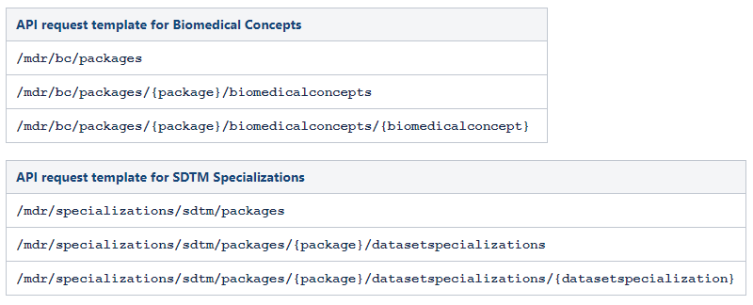
API Endpoints in CDISC Library
Biomedical Concepts and SDTM Specialization are published in packages
Packages have new content and updates to existing content
Not cumulative!
2022-10-26
2023-02-13
2023-03-31
2023-07-06
2023-10-03

Slide 29
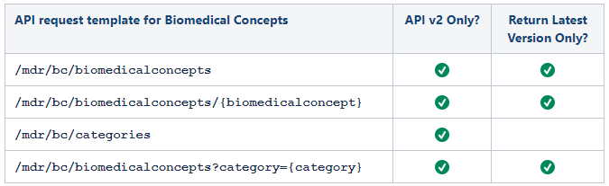
API Endpoints in CDISC Library
Biomedical Concepts and SDTM Specialization can now also be requested through the API (v2 only) with all the latest versions

Slide 30
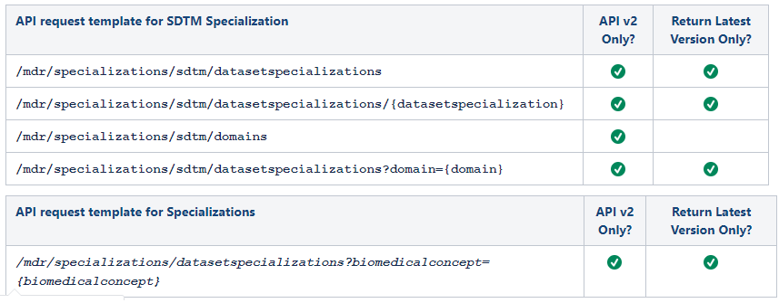
API Endpoints in CDISC Library
Biomedical Concepts and SDTM Specialization can now also be requested through the API (v2 only) with all the latest versions

Slide 31
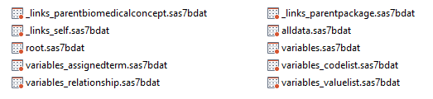
API Requests in SAS
%let ApiKey=<your_personal_api_key>;
%let baseURL=https://library.cdisc.org/api/cosmos/v2;
filename json_out temp;
proc http
method = 'GET'
url="&baseURL/mdr/specializations/sdtm/datasetspecializations/SYSBP"
out=json_out;
headers
"api-key" = "&ApiKey"
"Accept" = "application/json";
run;
filename json_map temp;
libname json_out json map=json_map automap=create fileref=json_out;
proc copy in = json_out out = work;
run;

Slide 32
Key Achievements and Next Steps
Current Status and Future Plans

Slide 33
CDISC Biomedical Concepts
2023 Key Achievements
Curation of new Biomedical Concepts (BCs) and SDTM Dataset Specializations
208 BCs and 171 SDTM Dataset Specializations currently available via CDISC Library APIs
Additional BCs and SDTM will be loaded end of Q42023
Streamlined curation process and documentation
New API Endpoints to find and retrieve BCs/SDTM Dataset Specializations
Established versioning and change management for BCs and APIs
Loaded multiple packages of BCs/SDTM Dataset Specializations
Retrieval of the latest version of BCs/SDTM across packages
Established lineage across versions
Supported CDISC Oncology SDS Team to create, validate and release BCs and SDTM Dataset Specializations for RECIST 1.1 Disease Response Criteria
Retrievable via CDISC Library APIs
Supported Digital Data Flow Phase 2-3 (DDF)
Created BCs/SDTM Dataset Specializations for example COVID and Alzheimer's protocols
Integration of CDISC BC model into USDM to support eDC automation

Slide 34
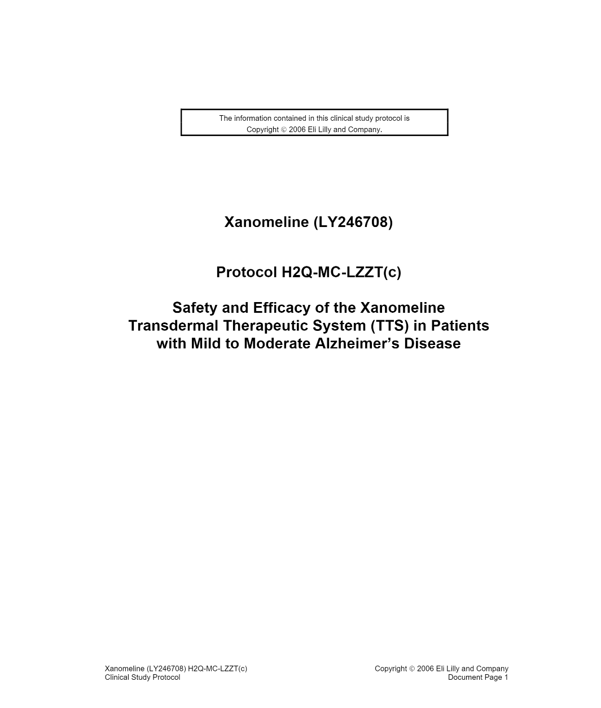
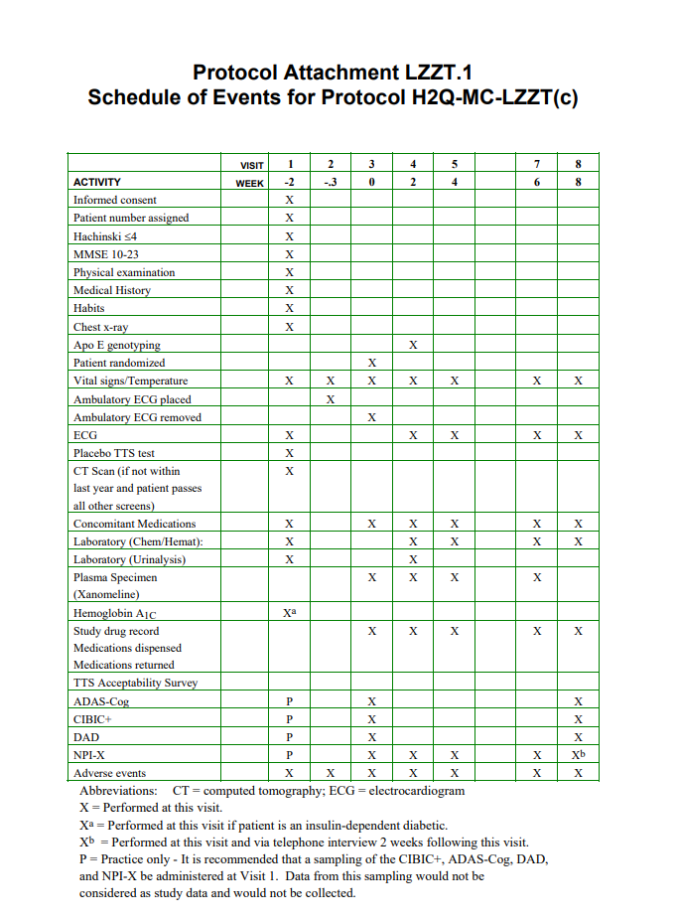
Supporting Digital Data Flow Phase 3 (DDF3)
DDF 3 Pilot Study
Development of additional biomedical concepts to cover the CDISC Pilot Study (LZZT)
Allows for a full exemplar USDM protocol Design

Slide 35
Supporting Digital Data Flow Phase 3 (DDF3)
Supporting Study Design and eDC automation
Integration of the CDISC BC model into USDM to support EDC automation
Building a complete set of BCs and SDTM Dataset Specializations for the Pilot Study (Alzheimer’s Disease)
Attaching CDISC BCs/SDTM Dataset Specializations to Activities which are in turn attached to timepoints in the SoA which provides:
Decision occurs at either protocol design or eDC stage
Ends with a detailed study specification (next level after SoA)
What’s the big deal?
Precise definition of all data points
Increased standardization and cross-study consistency
Higher quality specifications

Slide 36
Looking to Future
Upcoming Activities and Future Plans
CDASH dataset specializations
FHIR dataset specializations
Include metadata for transformational algorithms in CDISC Dataset Specializations
Participation and alignment with OAK project to begin building end to end data flow CDASH – SDTM, etc.
Support new TAUGs
Support CDISC Oncology SDS Team to create more BCs/SDTM Specializations
Migration of BC content from CDISC community
Currently working with Novo-Nordisk to migrate/load a sampling of their BCs to CDISC Library
Establish User friendly search, visualizations and exports
Continue to improve and streamline the BC curation process
Hoping to get more ‘BCs’ from the community

Slide 37


